Slide 2
Why Learn C?
there are some good reasons to learn to program in C. First, age has its advantages: C has been around for 30 years, and there is a ton of source code available. This means there's a lot to learn from, and a lot to use.
C is reasonably close to the machine. When you're working with pointers, bytes, and individual bits, things like optimization techniques start to make a lot more sense.

Slide 3
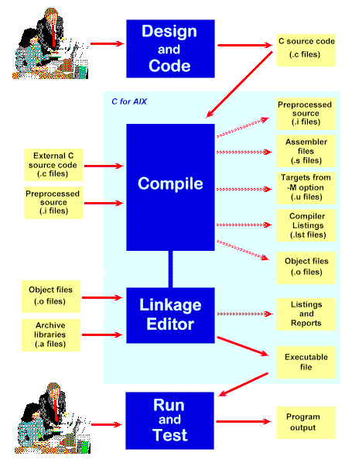
C Program Development Environment
A C program must go through various phases such as:
  Creating a program with editor
  Execution of preprocessor program
  Compilation
  Linking
  Loading
  Executing

Slide 4
Editor
Program is created in
the editor and stored
on disk.
Disk
Preprocessor
Disk
Preprocessor program
processes the code.
Compiler creates
object code and stores
it on disk.
Compiler
Disk
Linker links the object
code with the libraries,
Linker
Disk
Primary Memory
Loader
Loader puts program in memory.
Disk
.
.
.
.
.
.
Primary Memory
CPU
CPU takes each
instruction and
executes it, possibly
storing new data
values as the program
executes.
.
.
.
.
.
.

Slide 5
Difference between library and headerfile
Header File is the file where all the headers name are mentioned that going to be used or consumed in the main code file. | On other hand Library is the file where the implementation code of each header is written down which is mentioned in the Header file.

Slide 6
C Program Development Environment(cont.)
Phase 1: Create your program with an editor program
Phase 2: A preprocessor find some preprocessor directives (#include <stdio.h>) to include other files.
Phase 3: Compiler compiles the program into machine languages
Phase 4: A linker links the object code with the code in library or other places to produce an executable image.
Phase 5: A loader loads the executable image into memory (RAM).
Phase 6: CPU executes the program one instruction at a time. The load process in Windows OS is just input the name of the executable file.

Slide 7
MCQ
C language was invented in the year.?
A) 1999
B) 1978
C) 1972
D) 1990

Slide 8
Algorithm
Algorithm is defined as “ the finite set of steps, which provide a chain of action for solving a problem”
It is step by step solution to given problem.
Well organized, pre-arranged and defined textual computational module

Slide 9
Steps to create an Algorithm
1. Identify the Inputs
What data do I need?
How will I get the data?
In what format will the data be?
2. Identify the Outputs
What outputs do I need to return to the user?
What format should the outputs take?

Slide 10
Steps to create an Algorithm
3. Identify the Processes
How can I manipulate data to produce meaningful results?
Data vs. Information
4. Break the Solution to steps
By breaking the solution to the steps we can easily understand the logic of program

Slide 11
Algorithm: Add 2 Numbers
Problem: To add two numbers.
Step1. Start.
Step2. Take the two numbers.
Step3. Add them.
Step4. Print the result.
Step5. Stop.

Slide 12
Flow Chart
Flow Chart is pictorial representation of an algorithm.
Whatever we have done in algorithm we can represent it in picture.
It is easy to understand.
Shows the flow of the instruction

Slide 13
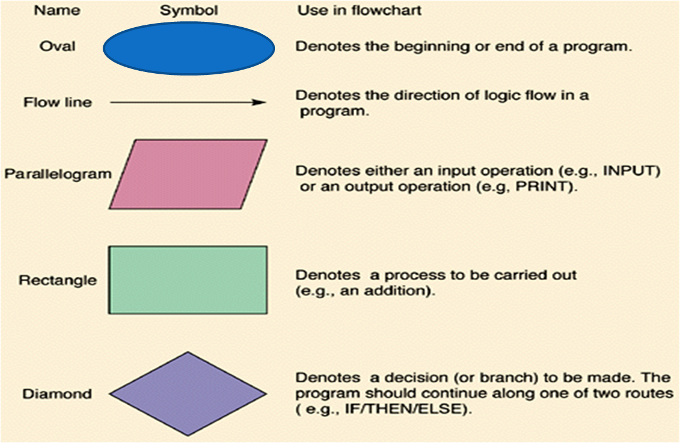
Flow Chart Symbols

Slide 14

Flow Chart: Add 2 Numbers
START
Quick yak:
Ask students to draw a flow chart for going to a movie…
TAKE TWO NUMBERS A and B
FIND SUM=A+B
PRINT SUM
STOP

Slide 15
Pseudocode
pseudocode statements that appear to have been written in a computer programming language but do not necessarily follow any syntax rules of any specific language.
The purpose of using pseudocode is that it is easier for people to understand than conventional programming language code, and that it is an efficient and environment-independent description of the key principles of an algorithm.

Slide 16
Example of Pseudocode
start
input myNumber
set myAnswer = myNumber * 2
output myAnswer
Stop

Slide 17
MCQ 1
Q1 The symbol denotes _______
I/O
Flow
Terminal
Decision

Slide 18
MCQ
C programs are converted into machine language with the help of
An editor
A compiler
An operating system
An interpreter

Slide 19
MCQ 2
Q2 Informal high level description of an
algorithm in english is called
A Function
B Class
C Pseudo code
D None of the above

Slide 20
Explanation
A simple C program consists of
  Comments (optional)
    //
    /*….*/
  Including header files
    #include<header file name>
  Functions
    main function as special function
    Other user defined functions (optional)

Slide 21
Comments in C
Two forward slashes ‘ // ’ (double forward slashes), are used to write single line comment
The next combination ‘ /*……..*/ ’ (forward slash with asterisk) is used for commenting multiple lines

Slide 22
Header files
  stdio.h: standard input output header file for functions printf(),scanf(),... and so on
  conio.h: console input output header file for functions getch()…. and so on

Slide 23
Header files
C code example
//Sample program
#include<stdio.h> //header file for printf()
#include<conio.h> //header file for getch()
int main()
{
//stdio.h is providing printf() function
printf(“Car is under process”);
//conio.h is providing getch() function
getch();
}
Program
Output:
Car is under process

Slide 24
Tokens
We have seen that Tokens are broadly classified as:
  Identifiers
  Keywords
  Constants
  Variables
  Strings
  Operators
  Special character

Slide 25
Identifier
All of them are not variables.
They are used to name a variable, a function, a class, a structure, a union.
It is created to give a unique name to an entity.
They can consist of alphabets, digits, and underscores.
There is no punctuation or special symbol, except the underscore.
It can be upper case or lower case.
It can start with lower case letter, upper case letter or an underscore.
It helps locate the name of the entity which is defined along with a keyword.

Slide 26
Variable
It is used to give a name to a memory location.
It holds a value.
The names of variables are different.
They help allot a unique name to a specific memory location.

Slide 27
Rules for naming a Variable
1. An variable name is any combination of 1 to 31 alphabets, digits or underscores.
3. No blanks or special symbol other than an underscore can be used in an variable name.
4. Keywords are not allowed to be used as variables.
2. The first character in the variable name must be an alphabet or underscore.

Slide 28
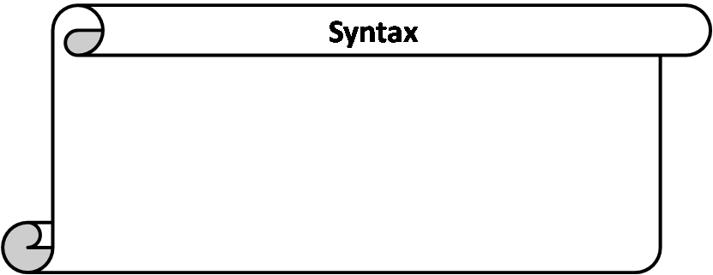
Variable Initialization
Assigning some value to the variable at time of creation of variable is known as variable initialization.
datatype variable_name = value;
Example: int radius= 15;
float pi = 3.14;
char grade = ‘A’;
Notes:
During declaration no memory space is allocated to an identifier.
Definition of identifier means the declaration of identifier + reservation of space for it in memory

Slide 29
Constants
The entity which do not change throughout the execution are called constants.
Types of constants:
  Integer constant
  Character constant
  Floating point constants
  String constants
Name of person remains same through out the life, example: Amit, Shubnam, etc.

Slide 30
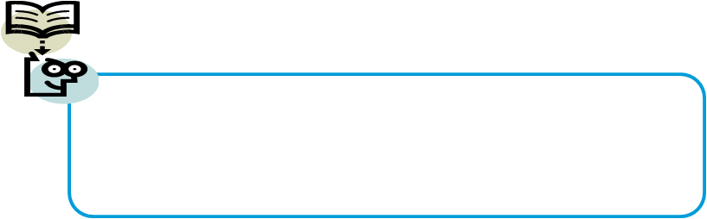
Integer Constants
  When the constant contains only digits without any decimal part
Floating Constant
  Constants that contains number with decimal points
  Example : 5;
  -987;
  Example : 3.14;
  309.89

Slide 31
Character constants
  Constants enclosed in single quotes(‘ ’).
  It can be any letter from character set.
String Constants
  Set of zero or more characters enclosed in double quotes (eg: “ ” )
  It is represented as sequence of characters within double quotes.
  Example : ‘\n’, ‘\t’ or ‘a’
  Example : “This is C programming”

Slide 32
MCQ
An Identifier may contain.?
A) Letters a-z, A-Z in Basic character set. Unicode alphabet characters other languages
B) Underscore _ symbol
C) Numbers 0 to 9 Unicode Numbers in other languages
D) All the above

Slide 33
Choose the correct
A) A constant value does not change. A variable value can change according to needs.
B) A constant can change its values. A variable can have one constant value only.
C) There is no restriction on number of values for constants or variables.
D) Constants and Variables can not be used in a singe main function

Slide 34
Choose the correct
Find a Character constant.
A) 'A' 'a'
B) '1' '9'
C) '$' '#'
D) All the above.

Slide 35
Operators
Operator is the symbol which performs some operations on the operands.
5+5=10
+ and = are the operator and
5 and 10 are operands

Slide 36
Expressions
Expressions are the statements or the instruction given to computer to perform some operation.
Every expression results in some value that can be stored in a variable.
Following are few example of expressions in program:
  Expression to calculate speed of a car.
    Speed=distance/time
  Expression to find similarity of two things.
    c=value1>value2
Notes:
A=b+c….three operands and 2 operators

Slide 37
Example: addition of two numbers, 5+8, these numbers will be operands.
Example: The addition, subtraction, etc will be operators
Expressions in C are basically operators acting on operands.
An operand is an entity on which operation is to be performed.
An operator specifies the operation to be applied on operands.
Expressions are made of one or more operands.
Statements like :
a = b + c,
300 > (8 * k)

Slide 38
What is length of an Identifier that is unique for Non Global Variables and Non Function Names.?
A) 32
B) 63
C) 64
D) 68
Answer B
Explanation: if 31 is present choose. Because old compilers support up to 31 only.
Upto first 63 characters you can show differentiation in the name of say
int abcdefghijklmnopqrstuvwxyz1234567788= 10;
int abcdefghijklmnopqrstuvwxyz1234567799 = 20;

Slide 39
Types of Operators
Types of operators are:
  Arithmetic operator
  Unary operator
  Relational operator
  Logical operator
  Assignment operator
  Conditional operator
  Bitwise operator
  Special operator

Slide 40
Description of Operators
Arithmetic Operators
These are binary operators i.e. expression requires two operands
Operator | Description | Example (a=4 and b=2)
+ | Addition of two operands | a + b = 6
- | Subtraction of two operands | a – b = 2
* | Multiplication of two operands | a * b = 8
/ | Division of two operands | a / b = 2
% | Modulus gives the remainder after division of two operands | a % b = 0

Slide 41
Unary Operator
These operator requires only one operand.
Operator | Description | Example(count=1)
+ | unary plus is used to show positive value | +count; value is 1
- | unary minus negates the value of operand | -count; value is -1
++ | Increment operator is used to increase the operand value by 1 | ++count; value is 2 count++; value is 2
-- | Decrement operator is used to decrease the operand value by 1 | --count; value is 1 count--; value is 1
++count increments count by 1 and then uses its value as the value of the expression. This is known a prefix operator.
count++ uses count as the value of the expression and then increments count by 1. This is known as postfix operator.

Slide 42
QUES 3
#include <stdio.h>
int main()
{
int i ;//declaration
i= 1, 2, 3;//initialize
printf("%d", i);
return 0;
}
a)1 c) prints 1,2,3
b)3 d) compile time error

Slide 43
MCQ 4
Operator % in C Language is called.?
A) Percentage Operator
B) Quotient Operator
C) Modulus
D) Division

Slide 44
MCQ 5
Choose a right statement.
int a = 4.867;
A) a = 10
B) a = 14.867
C) a = 14
D) compiler error.

Slide 45
MCQ 6
int main()
{
Int a=12
//int c=--a; //c=11 a=11
Int c=a--; //c=12 a=11
printf(“a=%d”, a);
return 0;
}
a)1 b) -2 c) 2 d)error

Slide 46
MCQ 7
int main()
{
int x = 4,y=0,z=0;
y = --x; //x=3 y=3
z = x--;// z=3 x=2
Pritnf(«this is me »
printf("%d, %d, %d\n", x, y, z);
return 0;
}
a) 4,3,3 b)3,3,3 c)2,3,3 d)4,4,3

Slide 47
Ques:8
#include<stdio.h>
int main()
{
int c=2.4;
printf("c=%f", c);
return 0;
}
0.000000
2.4
2
error

Slide 48



Relational Operator
It compares two operands depending upon the their relation. Expression generates zero(false) or nonzero(true) value.
Operator | Description | Example (a=10 and b=20)
< | less than, checks if the value of left operand is less than the value of right operand, if yes then condition becomes true. | (a < b) value is 1(true)
<= | less than or equal to, checks if the value of left operand is less than or equal to the value of right operand, if yes then condition becomes true. | (a <= b) value is 1 (true).
> | greater than, checks if the value of left operand is greater than the value of right operand, if yes then condition becomes true. | (a > b) value is 0 (not true).
>= | greater than or equal to, checks if the value of left operand is greater than or equal to the value of right operand, if yes then condition becomes true. | (a >= b) value is 1 (true).
== | equality ,checks if the value of two operands is equal or not, if yes then condition becomes true. | (a == b) value is 0 (not true).
!= | inequality, checks if the value of two operands is equal or not, if values are not equal then condition becomes true. | (a != b) value is 1 (true).

Slide 49
Logical Operator
  It checks the logical relationship between two expressions and the result is zero( false) or nonzero(true).
Operator | Description | Example
&& | Logical AND operator. If both the operands are true then condition becomes true. | (5>3 && 5<10) value is 1 (true).
| | | Logical OR Operator. If any of the two operands is true then condition becomes true. | (5>3 || 5<2) value is 1 (true).
! | Logical NOT Operator. Use to reverses the logical state of its operand. If a condition is true then Logical NOT operator will make false. | !(8==8) value is 0 (false).

Slide 50
Conditional Operator
Conditional operator contains condition followed by two statements. If the condition is true the first statement is executed otherwise the second statement.
It is also called as ternary operator because it requires three operands.
Operator | Description | Example
?: | conditional expression, Condition? Expression1: Expression2 | (a>b)? “a is greater”: “b is greater”

